Slide 1
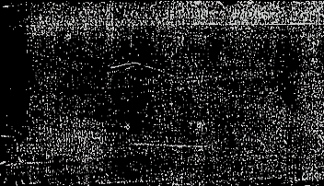

HIDDEN HUNGER DETECTION USING DEEP LEARNING APPROACHES
Under the guidance of:
Dr.A.Mookambiga M.Tech.,Ph.D.
BATCH-8 TEAM MEMBERS
1.Lavanya.L-953219106016
2.Pandimeena.R-953219106023
3.Ponchendila.N-953219106024
4.Subashini.P-953219106038

Slide 2
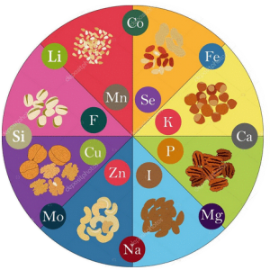
Outline
Introduction
Need
Why this topic
Literature survey
Objectives
Methodology
Block diagram
Results and discussion
Conclusion and future scope
References

Slide 3
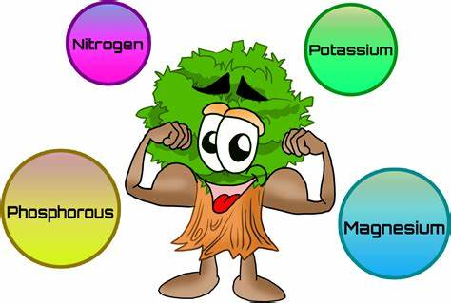
Introduction
‘Hidden hunger’ - describe deficiencies in essential vitamins and minerals, also known as micronutrients
Major Micronutrients:
In Human-Vitamin A,C,D,Fe,Ca,Mg,Iodine
In Plants-Zn,Fe,Mn,B

Slide 4
ROLE OF MICRONUTRIENTS
Vitamins and Minerals
Brain growth
Good health
Strength immune system
Healthy aging
Healthy babies
Normal growth

Slide 5
Hidden Hunger across the world
Micronutrient deficiencies affect an estimated two billion people, or almost one-third of the world’s population.
Preschool children
Vitamin A deficiency
Fe-deficiency
People Worldwide
Iodine deficiency
Zn-deficiency
30%
30%
18%
17%

Slide 6
HIDDEN HUNGER IN CROPS AND SOIL ACROSS INDIA
Crops and Soil
Zn-deficiency
Fe-deficiency
Mn-deficiency
Crops and Soil
Boron deficiency
Cu-deficiency
Molybdenum deficiency
49%
3%
12%
33%
5%
11%

Slide 7
NEED:
Human Health implications:
To improve the health and well-being of individuals- children and pregnant women.
Plant disease:
Identify micronutrient deficiencies-Plant susceptible to diseases.
For the development of sustainable agriculture practices- Promote plant health and reduce the risk of plant diseases.

Slide 8
Why this title?
All the existing methods focus on diagnosing macronutrient deficiencies
No awareness among people on micronutrient deficiencies
Micronutrient deficiency also causes serious damage to the growth of the plant/crop.

Slide 9
LITERATURE SURVEY:
Title of the paper | Year | Author and Journal | Description | Summary
Ensemble Averaging of Transfer Learning Models for Identification of nutritional deficiency in Rice plants | 2022 | Mayuri Sharma,Keshab Nath,Rupan Kumar Sharma et all MDPI-Electronics | Detect the nutrient deficiency in plants Host a high end system in cloud Used six CNN based DL architectures | Limitations: Detect only 3 mineral deficiency No ML classifier is used Summary: Highest performance InceptionResNetV2(90%) and Xception(95.83%)

Slide 10
Title of the paper | Year | Author and Journal | Description | Summary
A comparative Study of Deep CNN in Forecasting and Classifying the Macronutrient Deficiencies on Development of Tomato Plant | 2019 | Trung-Tin Tran,Jae-Won Choi,Thein-Tu Huynh Le and Jong-Wook Kim MDPI-applied sciences | Calcium,Nitrogen, Potassium deficiency in tomato plant ANN model is used Inception ResnetV2, Autoencoder and Ensemble Averaging are the 3 models which are used | Accuracy rate obtained 87.27% -Inception-Resnet v2 79.09% - Autoencoder to 91% - ensemble averaging.

Slide 11
Title of the paper | Year | Author and Journal | Description | Summary
Using Deep Convolutional Neural Network for Image Based Diagnosis of Nutrient Defeciencies in Plants Grown in Aquaponics | 2022 | Mohamed Farag Taha et all MDPI-chemosensors | Diagnoses the nutrient status(N,P,K,FN) of lettuce in aquaponics It integrate color imaging and deep convolution neural network(DCNNs) | SegNet for segmentation, Inceptionv3 and Resnet18 for classification Highest classification accuracy-96.5% Real time disease detection

Slide 12
Title of the paper | Year | Author and Journal | Description | Summary
Deep Learning for Non Invasive Diagnosis of Nutrient Deficiencies in Sugar Beet Using RGB images | 2020 | Jinhui Yi ,Lukas Krusenbaum et all MDPI-Sensors | Determine the nutrient deficiency (N,P,K) in sugar beet Five CNN based DL architectures | Accurate detection is not possible by non invasive methods Recognizing deficiency during growing stages is difficult

Slide 13
Title of the paper | Year | Author and Journal | Description | Summary
Deep Learning Based Disease, Pest Pattern and Nutritional Deficiency Detection System For “Zingiberaceae” Crop | 2022 | Hamna Waheed,Noureen Zafar,Waseem Akram,Awais Manzoor,Abdullah Gani MDPI-agriculture | Determine the soft rot disease,deficiency and pest pattern in ginger plant leaf ANN and CNN are used MobileNetV2 and VGG are the training algorithms | 3 types-deficiency and healthy,Pest pattern and Healthy,Soft rot disease and healthy VGG-16 accuracy 96% - pest pattern ANN accuracy 97%-deficiency

Slide 14
Title of the paper | Year | Author and Journal | Description | Summary
Identifying Individual Nutrient Deficiencies of Grapevine Leaves using Hyperspectral Imaging | 2021 | Sourabhi Debnath,Manoranja Paul et all MDPI-remote sensing | Determine the N,K,Mg nutrient deficient in grapevine SVM is used to demonstrate the feature Features applied- reflectance ratio,mean derivative reflectance,variation index,mean spectral ratio,normalized difference vegetation index | Average F measure for SVM algorithm -93.19% Confusion matrix –visualize the performance

Slide 15
Title of the paper | Year | Author and Journal | Description | Summary
Nutritient Deficiency detection in maize(Zea Mays L.) leaves using image processing | 2022 | Nurbaity Sabri,Nurul Shafekah kassim,Shafaf Ibrahim,Rosniza Roslan,Nur Nabilah Abu IAES International Journal of AI(IJ-AI) | Determine nutrient deficiency(Mg,N,P) maize plant leaf Random forest were used as classifier to achieve accuracy of 78.35% Combination of GLCM hu and color histogram | Limitations: Result of P detection affected by its similarity with Mg features Future Scope: Some deficiency have same trait More data can be collected

Slide 16
Title of the paper | Year | Author and Journal | Description | Summary
Detection and classification of nutrient deficiencies in plants using machine learning | 2021 | Anu Jose,S Nandagopalan,Vidya Ubalanka and Dhanya Viswanath ICMMCMSE 2020 Journal of Physics | Detect the deficiency (N,Mg,P,K,S,C) Image can be uploaded on server Processed by image processing system (ANN model) Image Sementation,Feature extraction and classification is done | Best model-Features from Hue based segmentation ANN accuracy-88.27% Design of CNN can give better accuracy

Slide 17
Title of the paper | Year | Author and Journal | Description | Summary
Plant Nutrient Deficiency Detection Using Deep Convolutional Neural Network | 2019 | Lili Ayu Wulandhari,Alexander Agung et all ICIC International | Recognize and predict healthy and deficiency okra Inception Resnet architecture & fine tuning from ImageNet dataset is applied | Accuracy – 97% & 86% for testing and training Improvement can ben done by Mobilenet to implement in mobile

Slide 18
Title of the paper | Year | Author and Journal | Description | Summary
A nutrient Deficiency Prediction Method using Deep learning on development of Tomato fruits | 2018 | Choi Jae-Won,Tin Tran Trung et all International Conference on Fuzzy Theory and its application iFuzzy | Recognize and predict calcium and potassium deficiency CNN with Inception ResV2 network Uses Digital camera to capture image | High accuracy Algorithm can be upgraded to detect accurately

Slide 19
Gap in Literature survey
All the paper majorly focus only on macronutrient deficiency detection.
Only few research work have been done in the field of micronutrient deficiency detection.

Slide 20
Objectives
To detect hidden hunger at early stages using image processing techniques.
To determine the micronutrient deficiency in human and plants.
To implement various deep learning model and analyze its performance.
To create a webpage for the developed model.

Slide 21
BLOCK DIAGRAM
Input
dataset
Data
Augmentation
Splitting the
dataset
Feature Extraction
Using
Deep learning
models
Image
From net
Built
model
Prediction as Healthy or specific micronutrient deficiency
Classification using
Deep learning models
Web Page Development for Hidden Hunger detection in Human and Plants
Performance
Analysis

Slide 22
Data AUGMENTATION
Artificially increasing the training set by creating modified copies of a dataset using existing data
Geometric & color space transformations (flipping, resizing, cropping, brightness, contrast)
Prevents model from overfitting, improve the accuracy

Slide 23
Splitting the dataset
Data splitting - avoid overfitting
Overfitting-If our model does much better on the training set than on the test set
Training set, testing set, validation set

Slide 24
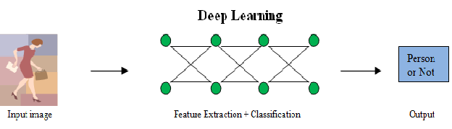
DEEP LEARNING MODEL
Deep learning uses neural networks to learn useful representations of features directly from data
Machine is trained to perform tasks using an algorithm or a predefined set of steps

Slide 25
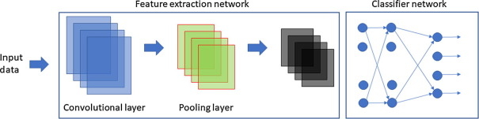
FeATURE EXTRACTION
The process of transforming raw data into numerical features
This technique is used to detect features in digital images such as edges , shapes or motion

Slide 26
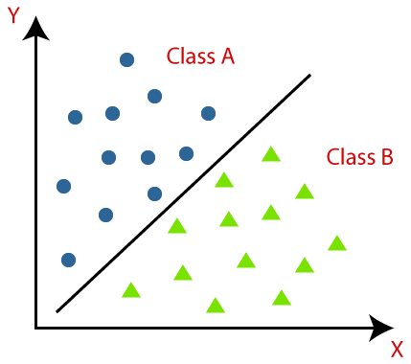
CLASSIFICATION
A supervised learning technique that categorizes a set of data into classes
The objective is to identify and portray as a unique gray level , the features occurring in an image

Slide 27
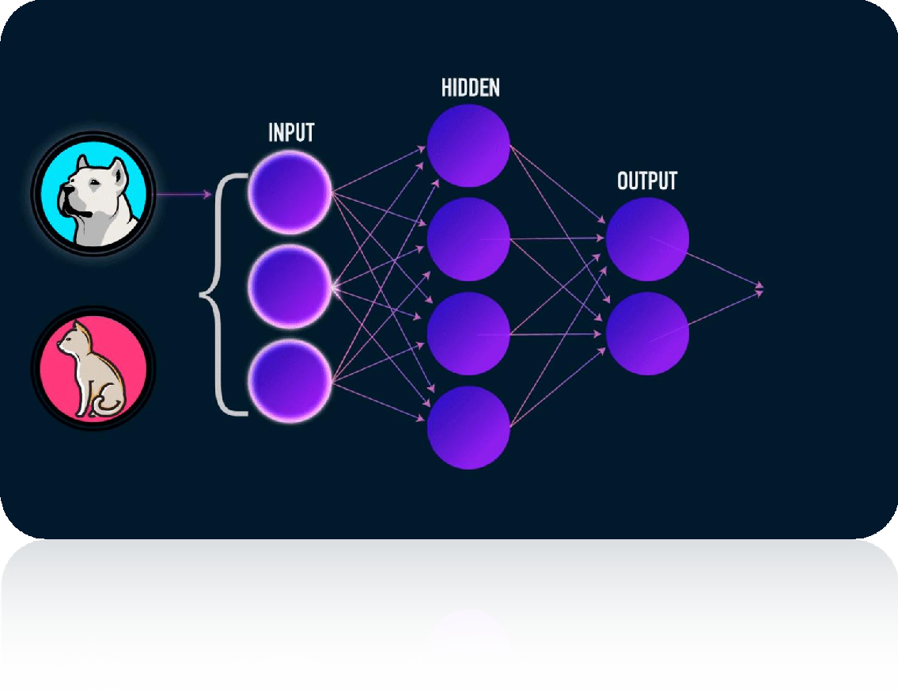
Convolution neural network
CNN Deep learning neural network
Process structured arrays of data such as images
Used in visual applications such as image classification

Slide 28



How CNN Operates?
CNN
Happy
CNN
Sad

Slide 29
CNN Layers
Convolution layer
Pooling layer
Flatten layer
Fully connected layer

Slide 30
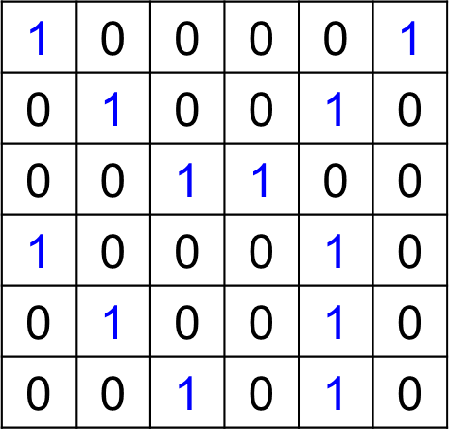
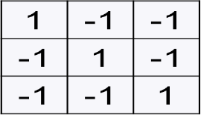
CONVOLUTION LAYER
Image
Feature Detector
Feature map
3 | -1 | -3 | -1
-3 | 1 | 0 | -3
-3 | -3 | 0 | 1
3 | -2 | -2 | -1
=
*
IBM Career Education © 2022 IBM Corporation

Slide 31
MAX POOLING LAYER
3 | -1 | -3 | -1
-3 | 1 | 0 | -3
-3 | -3 | 0 | 1
3 | -2 | -2 | -1
3 | 1 | 0
1 | 1 | 1
3 | 0 | 1

Slide 32
FLATTENING LAYER
3
1
0
1
1
1
3
0
1
3 | 1 | 0
1 | 1 | 1
3 | 0 | 1

Slide 33
FULLY CONNECTED LAYER
x1
x2
Flattening Layer
Hidden layers
Output Layer

Slide 34
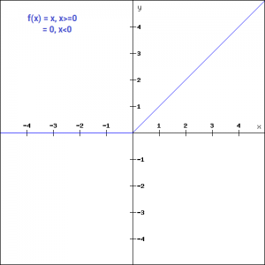
ReLU(RECTIFIED LINEAR UNIT)
ReLU is a commonly used activation function
Returns zero if the input is negative
The input value itself if it is positive
Mathematically, it is expressed as
f(x) = max(0,x)
where,
x -input to the function
f(x)-output
Prevent the vanishing gradient problem

Slide 35
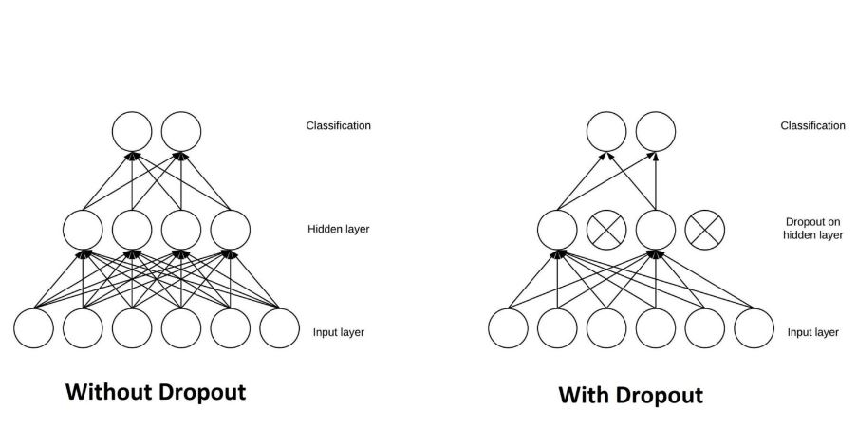
DROPOUT LAYER
The Dropout layer nullifies the contribution of some neurons towards the next layer and leaves unmodified all others
Prevent overfitting on the training data

Slide 36
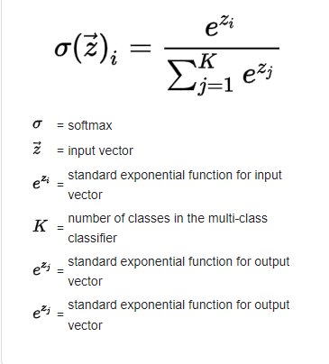
SOFTMAX LAYER
Placed before the output layer in a neural network
It converts the scores to a normalized probability distribution
Used as the activation function for multi-class classification problems

Slide 38
RESNET
It is a Convolutional Neural Network (CNN) architecture designed to support hundreds or thousands of convolutional layers
Resnet152v2 process the input image by 152 convolutional layers and the image is reshaped.
RESNET152V2

Slide 39
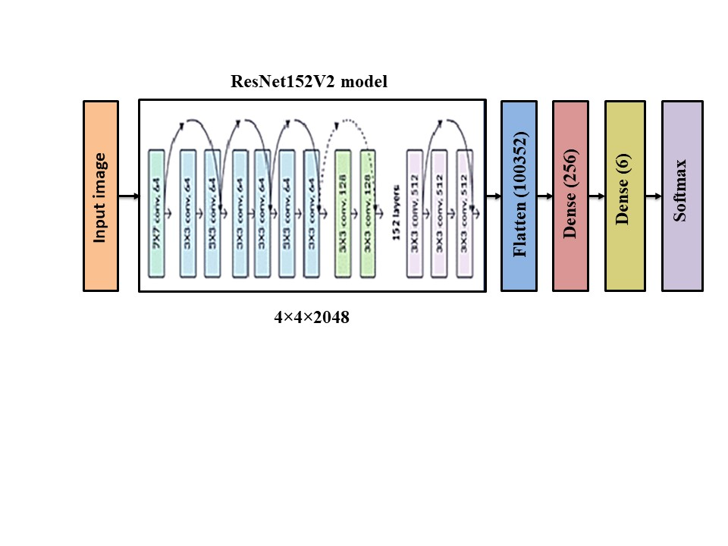
RESNET152V2 ARCHITECTURE

Slide 40
INCEPTION V3
Inception v3 is a deep neural network architecture for image classification, developed by Google in 2015.
The Inception v3 architecture uses a CNN with multiple layers of convolutional and pooling layers, followed by several fully connected layers.

Slide 41
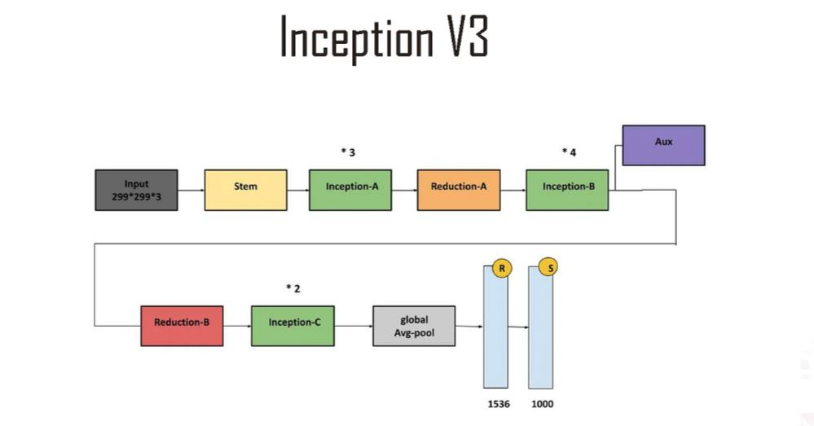
INCEPTION ARCHITECTURE

Slide 42
XCEPTION
Xception is a deep convolutional neural network architecture that involves depthwise separable convolutions.
Xception is also known as extreme version of inception module.

Slide 43
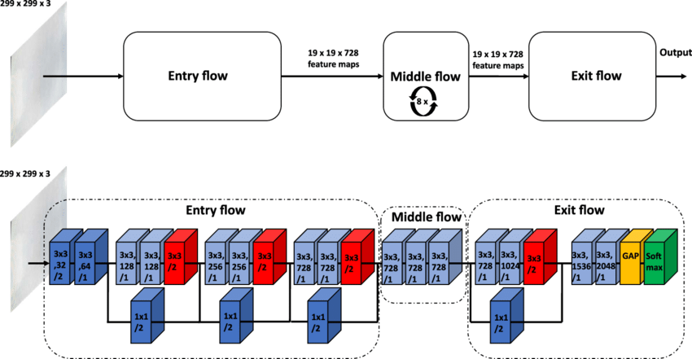
XCEPTION ARCHITECTURE

Slide 44
MOBILE NET
An efficient & portable CNN architecture used in real world applications.
Uses depthwise seperable convolutions in place of the standard
MobileNets introduce two new global hyperparameters(width multiplier and resolution multiplier)

Slide 45
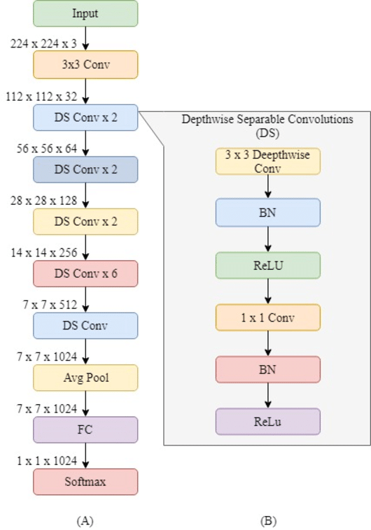
MOBILENET ARCHITECTURE

Slide 46
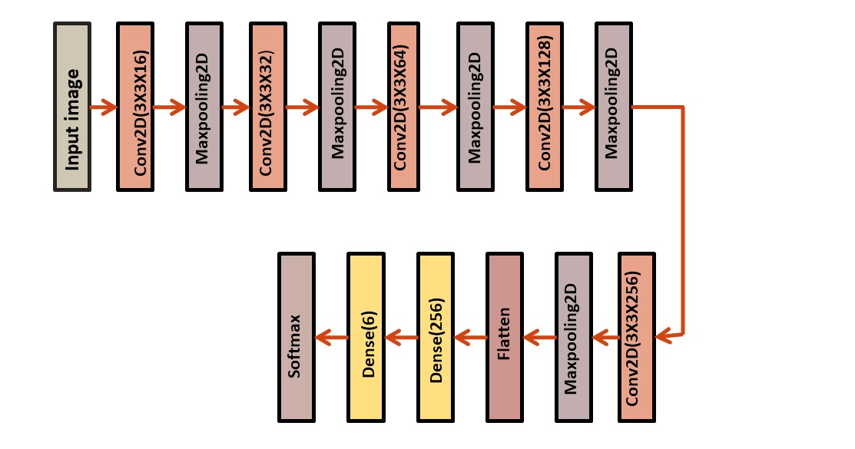
CNN MODEL ARCHITECTURE

Slide 47
PREDICTION
The process of using a trained model to estimate or forecast an unknown or future outcome based on input data.
It involves applying the learned patterns and relationships in the training data to make an informed inference about new, unseen data.

Slide 48
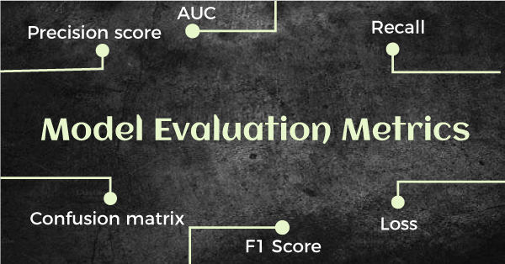
PERFORMANCE MEASUREMENT
Performance metrics are used to determine the effectiveness of image processing technique in achieving expected results.

Slide 49

Confusion Matrix
A technique for summarizing the performance of a classification algorithm

Slide 50
RECALL
Recall tells us about how well the model identifies true positives
TP
FN+TP
PRECISION
The precision of the model is the proportion of correct positive predictions
TP
FP+TP

Slide 51
F1-SCORE
F1 Score is a weighted average of precision and recall
F1-Score = 2 x precision x recall
precision+recall
SUPPORT
Number of occurrences of each class in the true
responses
calculate it by summing the rows of the confusion matrix

Slide 52
RESULTS AND DISCUSSION

Slide 53
HIDDEN HUNGER DETECTION IN HUMAN
INPUT DATA
Sample images from each classes in nail dataset
Healthy
Iodine
Zinc
Vitamin D
Vitamin B12
Iron

Slide 54
Sample input from each classes in eye dataset
Vitamin D-Deficiency
Healthy Eye
DATASET SOURCE
Roboflow - https://universe.roboflow.com/knm/nail-disease-detection-mxoqy
Kaggle - https://www.kaggle.com/datasets/kondwani/eye-disease-dataset

Slide 55
DATA AUGMENTATION
Augmentation techniques used
Zoom
Flip
Random Brightness
Sample Images After Data Augmentation
Zoom
Flip Top-Bottom
Random Brightness

Slide 56
DATA AUGMENTATION ON HUMAN DATASET
80%
TRAIN
20%
VALIDATION
DATA | BEFORE AUGMENTATION (3500) | AFTER AUGMENTATION (5000) | AFTER AUGMENTION (7000)
Iodine | 574 | 912 | 1189
Iron | 567 | 851 | 1188
Vitamin B12 | 572 | 840 | 1236
Vitamin D | 584 | 883 | 1194
Zinc | 455 | 705 | 975
Healthy | 558 | 809 | 1218
TOTAL IMAGES | 3500 | 5000 | 7000

Slide 57
HIDDEN HUNGER DETECTION IN PLANTS
INPUT DATA
Sample input from each classes in eye dataset
Boron
Iron
Manganese
Zinc
DATASET SOURCE
Mendeley-https://data.mendeley.com/datasets/7vpdrbdkd4

Slide 58
DATA AUGMENTATION
Augmentation techniques used
Zoom
Flip top bottom
Random Brightness
Random Distortion
Sample Images After Data Augmentation
Zoom
Flip
Random brightness
Random distortion

Slide 59
DATA AUGMENTATION ON LEAF DATASET
70%
TRAIN
10%
VALIDATION
20%
TEST
DATA | BEFORE AUGMENTATION | AFTER AUGMENTATION | AFTER AUGMENTATION
Boron | 100 | 800 | 1200
Iron | 86 | 750 | 1000
Manganese | 24 | 150 | 700
Zinc | 400 | 800 | 900
Healthy | 950 | 1200 | 1200
TOTAL IMAGES | 1560 | 3700 | 5000

Slide 60
MODEL BUILDING
The CNN model we used for model building of nail and eye dataset are
Inception V3
Resnet152V2
CNN model
Xception
Mobile net
Resnet152V2
Train accuracy-96.61
Test accuracy-90.94
Xception
Train accuracy-94.52
Test accuracy-83.02
Test accuracy-83.67
Train accuracy-92.46
Inceptionv3
Mobilenet
Train accuracy-95.52
Test accuracy-83.18
CNN model
Train accuracy-86.10
Test accuracy-68.47

Slide 61
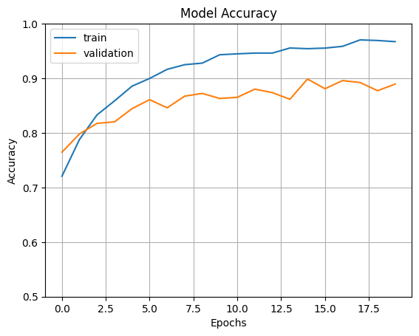
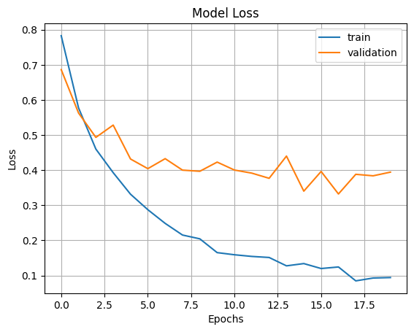
RESNET 152 V2
Model accuracy and loss plot is shown below
No of epochs-20

Slide 62
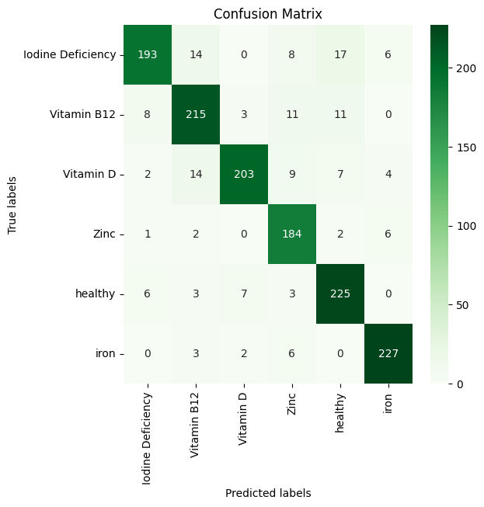
CONFUSION MATRIX
 | Precision | recall | F1-score | support
Iodine | 0.92 | 0.81 | 0.86 | 238
Vitamin B12 | 0.86 | 0.87 | 0.86 | 248
Vitamin D | 0.94 | 0.85 | 0.89 | 239
Zinc | 0.83 | 0.94 | 0.88 | 195
Healthy | 0.86 | 0.92 | 0.89 | 244
Iron | 0.93 | 0.95 | 0.94 | 238
accuracy |  |  | 0.89 | 1402

Slide 63
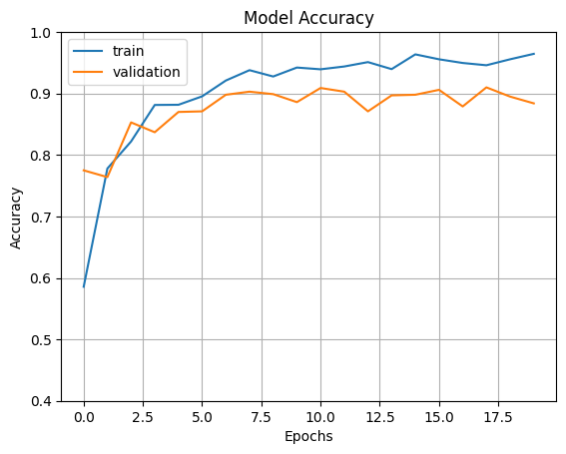
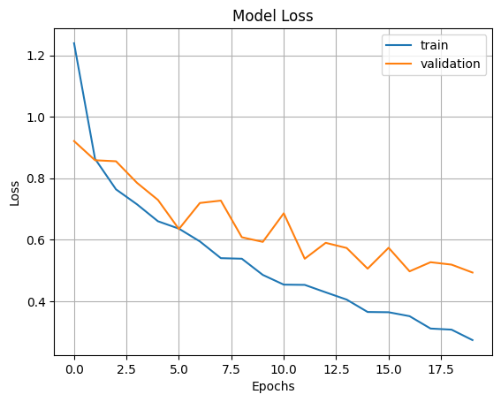
INCEPTION V3
Model accuracy and loss plot is shown below
No of epochs-20

Slide 64
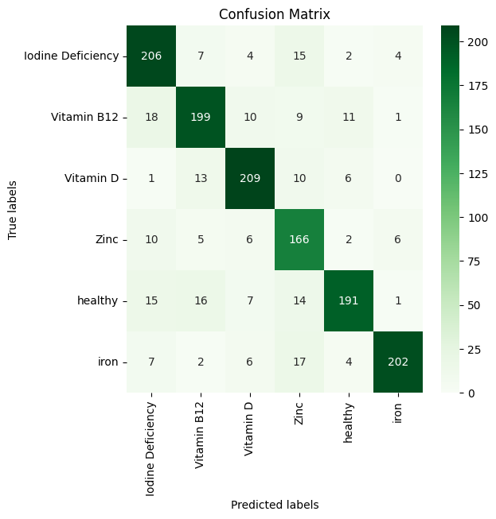
CONFUSION MATRIX
 | precision | recall | F1-score | support
Iodine | 0.80 | 0.87 | 0.83 | 238
Vitamin B12 | 0.82 | 0.80 | 0.81 | 248
Vitamin D | 0.86 | 0.87 | 0.87 | 239
Zinc | 0.72 | 0.85 | 0.78 | 195
Healthy | 0.88 | 0.78 | 0.83 | 244
Iron | 0.94 | 0.85 | 0.89 | 238
accuracy |  |  | 0.84 | 1402

Slide 65
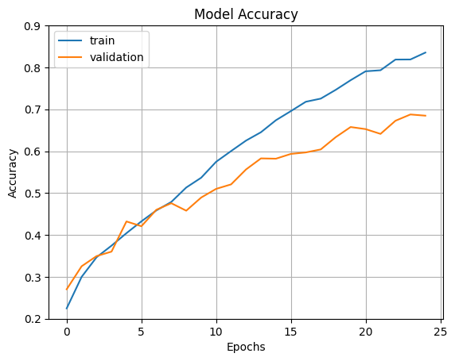
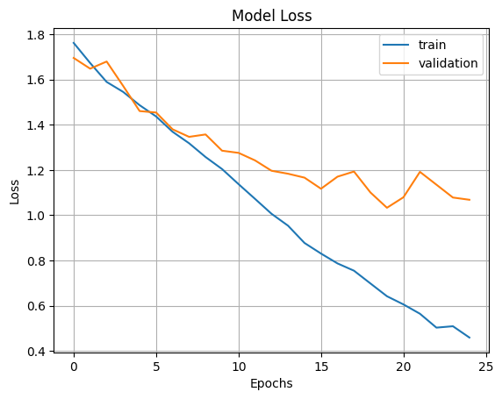
CNN Model
Model accuracy and loss plot is shown below
No of epochs-20

Slide 66
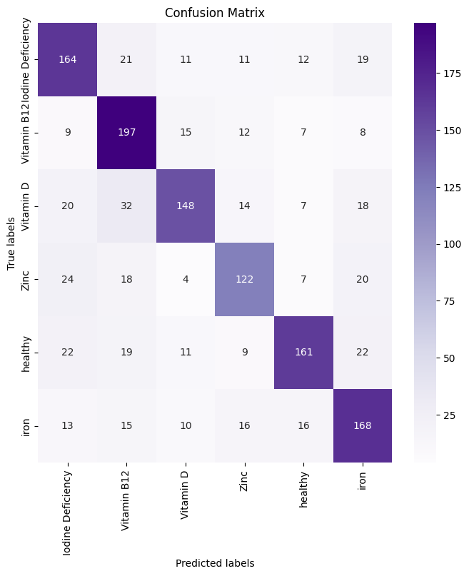
CONFUSION MATRIX
 | precision | recall | F1-score | support
Iodine | 0.65 | 0.69 | 0.67 | 238
Vitamin B12 | 0.65 | 0.79 | 0.72 | 248
Vitamin D | 0.74 | 0.62 | 0.68 | 239
Zinc | 0.66 | 0.63 | 0.64 | 195
Healthy | 0.77 | 0.66 | 0.71 | 244
Iron | 0.66 | 0.71 | 0.68 | 238
accuracy |  |  | 0.68 | 1402

Slide 67
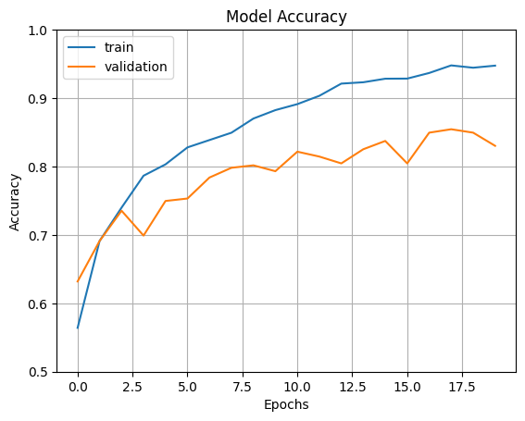
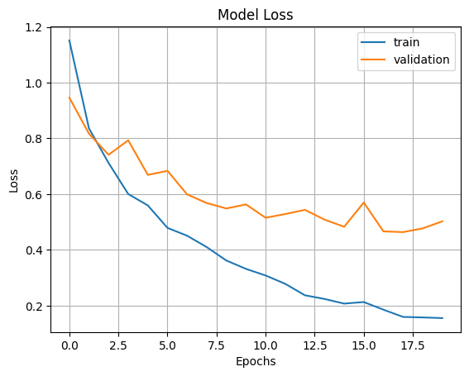
XCEPTION NET
Model accuracy and loss plot is shown below
No of epochs-20

Slide 68
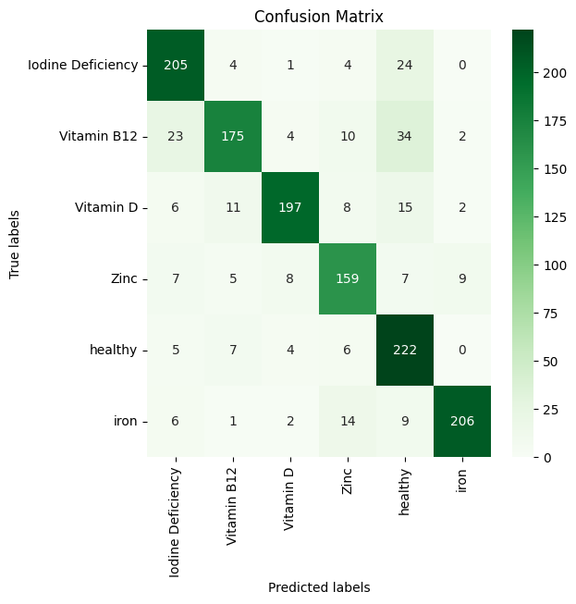
CONFUSION MATRIX
 | precision | recall | F1-score | support
Iodine | 0.81 | 0.86 | 0.84 | 238
Vitamin B12 | 0.86 | 0.71 | 0.78 | 248
Vitamin D | 0.91 | 0.82 | 0.87 | 239
Zinc | 0.79 | 0.82 | 0.80 | 195
Healthy | 0.71 | 0.91 | 0.80 | 244
Iron | 0.94 | 0.87 | 0.90 | 238
accuracy |  |  | 0.83 | 1402

Slide 69
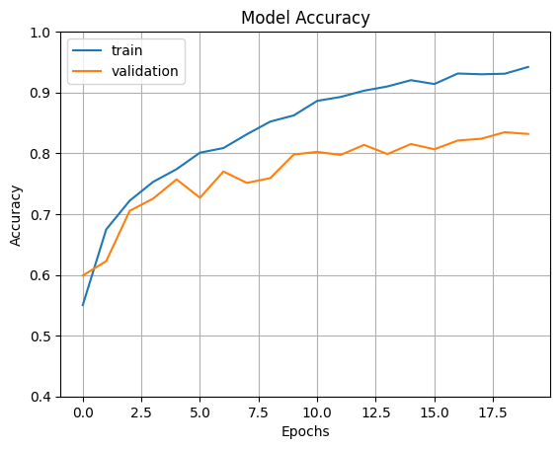
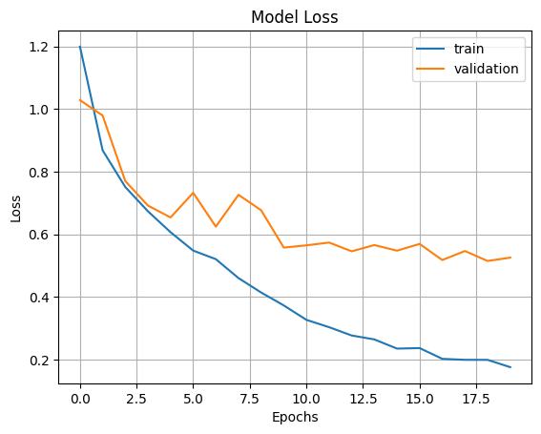
MOBILE NET
Model accuracy and loss plot is shown below
No of epochs-20

Slide 70
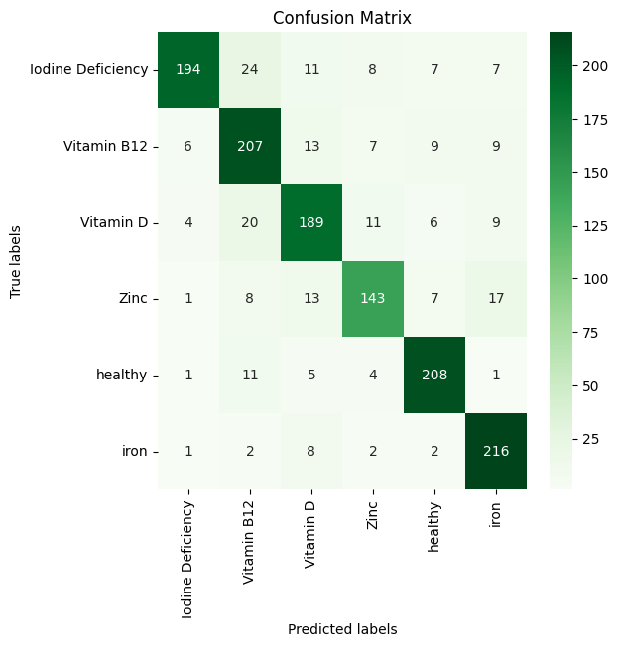
CONFUSION MATRIX
 | Precision | recall | F1-score | support
Iodine | 0.94 | 0.77 | 0.85 | 238
Vitamin B12 | 0.79 | 0.82 | 0.79 | 248
Vitamin D | 0.79 | 0.79 | 0.79 | 239
Zinc | 0.82 | 0.76 | 0.79 | 195
Healthy | 0.87 | 0.90 | 0.89 | 244
Iron | 0.83 | 0.94 | 0.88 | 238
accuracy |  |  | 0.83 | 1402

Slide 71
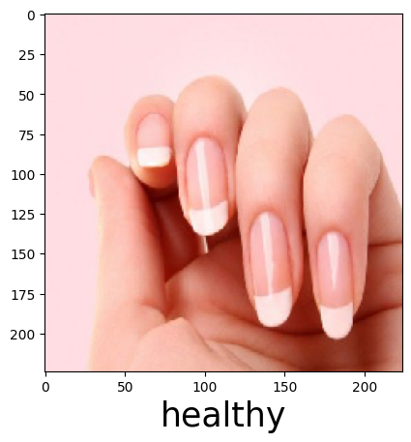
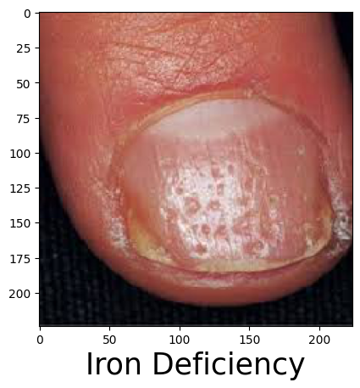
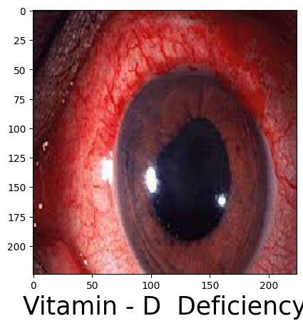
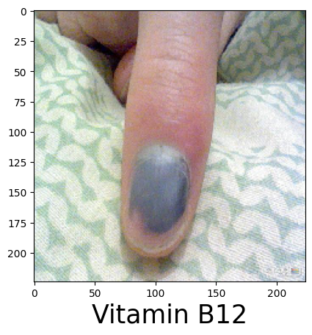
IMAGE PREDICTION
Images are selected in random manner and predicted using the built models

Slide 72
MODEL BUILDING
The CNN model we used for model building of leaf dataset are
Inception V3
Resnet152V2
CNN model
Xception
Mobile net
Resnet152V3
Test accuracy-93.00%
InceptionV3
Trainaccuracy-96.80%
Test accuracy-90.40%
CNN model
Test accuracy-80.60%
Trainaccuracy-97.31%
Trainaccuracy-83.00%
Mobile net
Train accuracy-97.20%
Test accuracy-92.30%
Xception
Train accuracy-96.57%
Test accuracy-91.40%

Slide 73
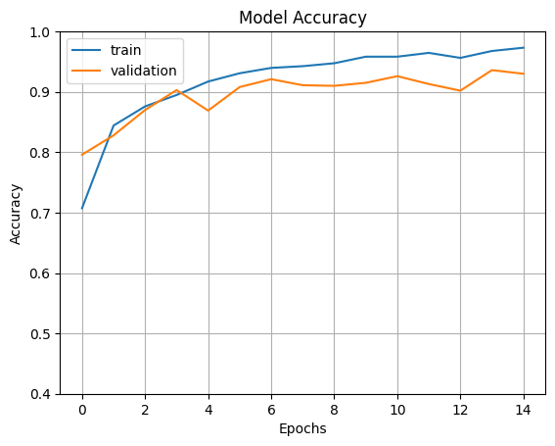
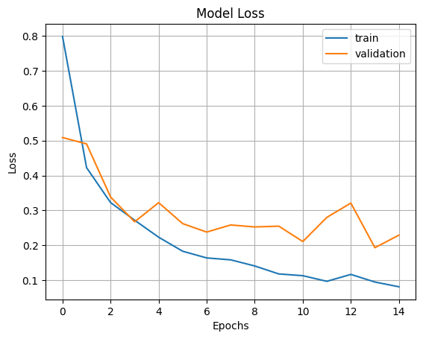
RESNET 152 V2
Model accuracy and loss plot is shown below
No of epochs-15

Slide 74
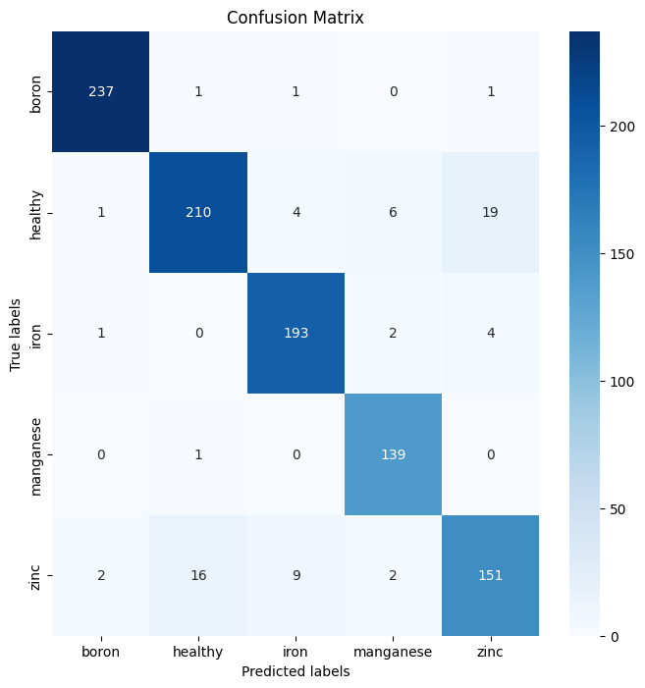
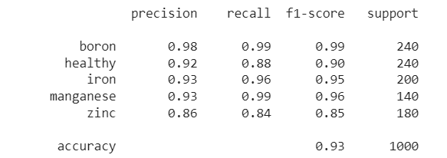
CONFUSION MATRIX

Slide 75
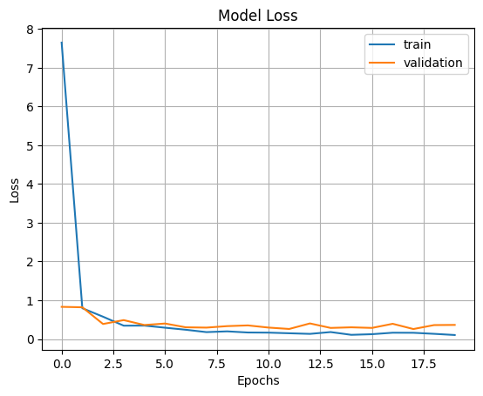
Inception V3
Model accuracy and loss plot is shown below
No of epochs-20

Slide 76
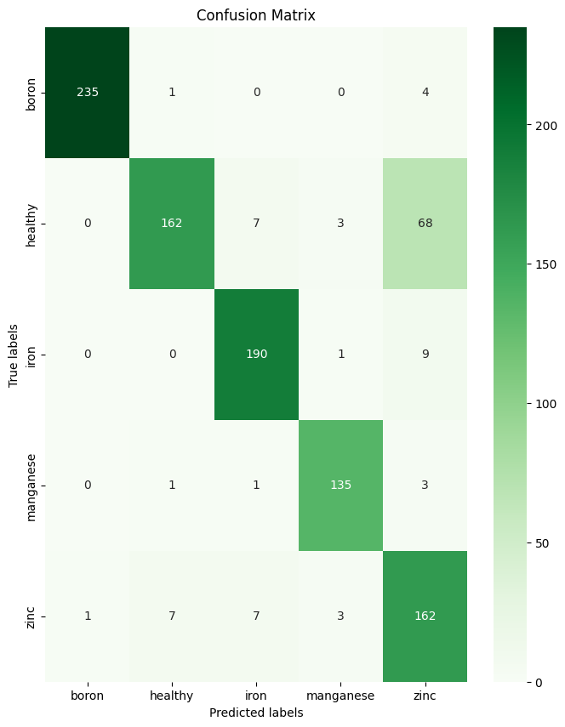
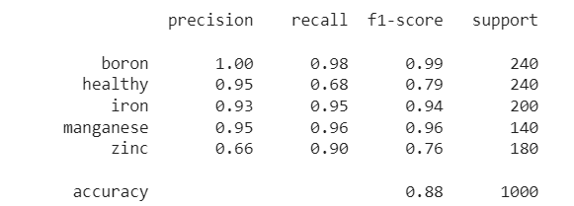
CONFUSION MATRIX

Slide 77
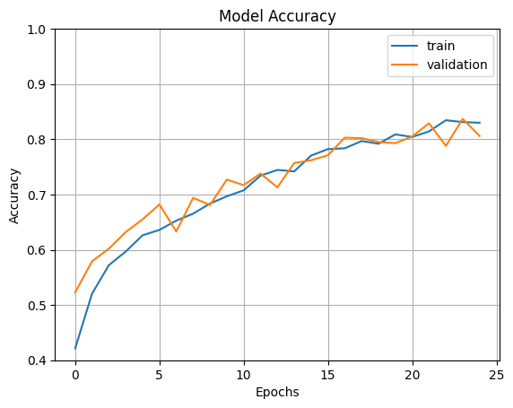
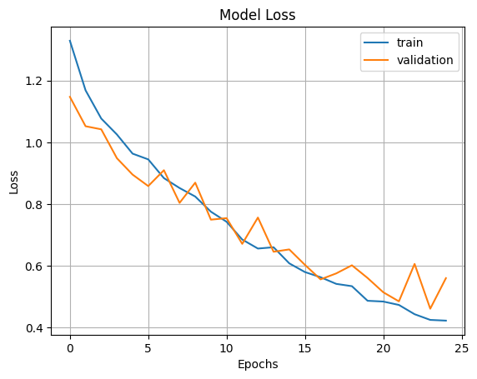
CNN Model
Model accuracy and loss plot is shown below
No of epochs-25

Slide 78
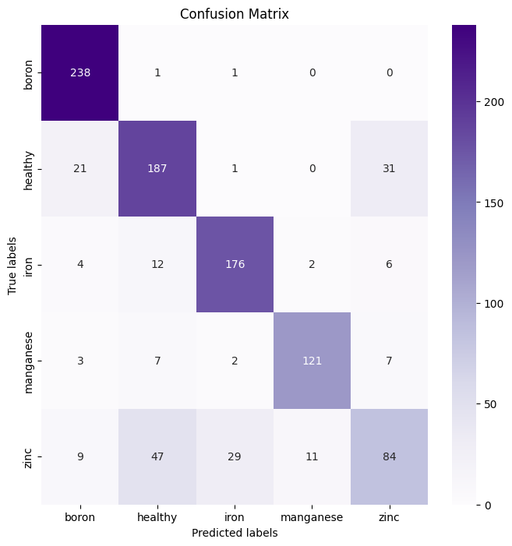
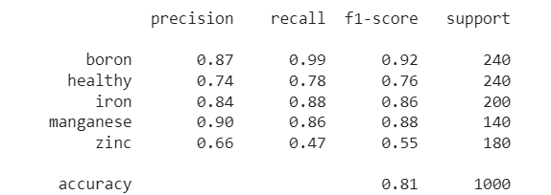
CONFUSION MATRIX

Slide 79
MOBILE NET
Model accuracy and loss plot is shown below
No of epochs-20

Slide 80
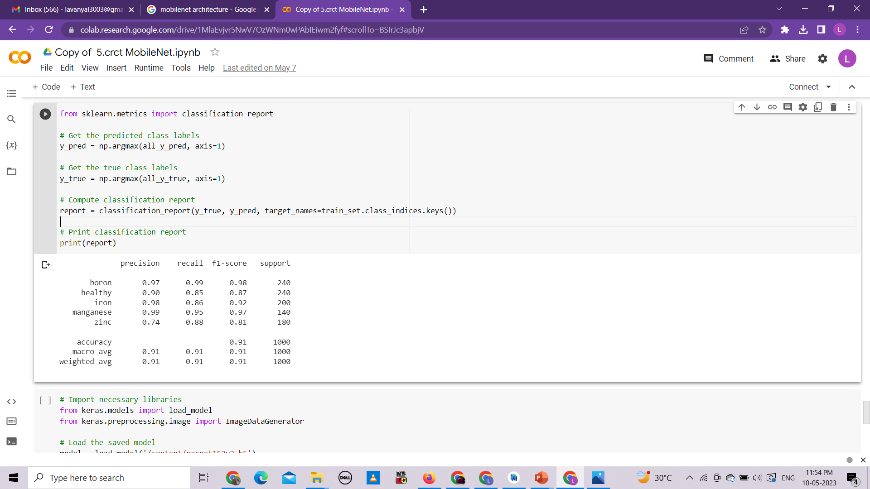
CONFUSION MATRIX

Slide 81
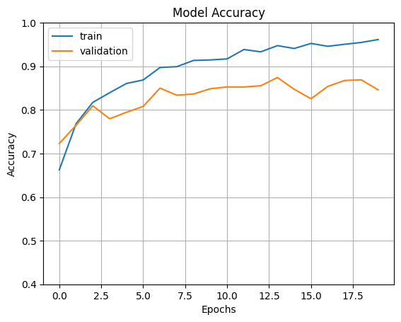

XCEPTION NET
Model accuracy and loss plot is shown below
No of epochs-20

Slide 82

CONFUSION MATRIX

Slide 83




IMAGE PREDICTION
Images are choosen randomly from the test dataset and the browser , it is predicted using the above built cnn models

Slide 84

Performance Measurement Analysis
For nail dataset the plot for precision comparison is

Slide 85

The plot for the comparison of f1 score of various models is

Slide 86

The plot for the comparison of recall of various models is

Slide 87


For leaf dataset the performance measurement graph for various model is shown below
The plot for the comparison of precision of various models is

Slide 88

The plot for the comparison of F1 score of various models is

Slide 89
The plot for the comparison of recall of various models is

Slide 90
inference
Resnet is considered to be the best as it performs well for all the classes
CNN model gives comparatively low accuracy, precision & recall in human dataset
The class zinc has low value in all metrics because its feature is similar to the feature of healthy

Slide 91

Computational TIME comparison
More time to train –Xception
Maximum time-110 mins
Minimum time-36 mins 42 secs
Resnet - best with comparatively low time and highest accuracy
Time in Human Dataset

Slide 92

Computational TIME comparison
More time to train –inception and mobilenet
Maximum time-60 m 2 s
Minimum time-38m
Resnet -low time and highest accuracy
Time in Leaf Dataset

Slide 93
WEBSITE DEVELOPMENT
Website for the machine learning model can be created using streamlit library
Streamlit-an open source Python library ,easy to create and share beautiful, custom web apps for machine learning and data science
Web app runs on local host
Ngrok is used to share it as public link which can be accessed by everyone

Slide 94

OUTLOOK of our website
Link of our website-https://3869-117-209-173-139.ngrok-free.app

Slide 95

This is our website which has three pages
Homepage-details of our project
human-second page where deficiency in human can be identified
Plant-Third page where deficiency in leaves can be identified

Slide 96

Steps
1.Click browse file options and select an image

Slide 97

2.After the selected image is loaded , a button to generate prediction will be enabled

Slide 98

3.Upon clicking generate prediction, the predicted class for the given image is displayed

Slide 99


Slide 100
FUTURE SCOPE
This model can be developed further to predict more number of deficiency classes in both human and plants so that it can be used in the real world
Micronutrient deficiencies can also be detected in fruits, vegetables and soil
An app can be developed with more user friendly interface for the real time and easy processing

Slide 101
References
A. S. Eldeen, M. AitGacem, S. Alghlayini, W. Shehieb and M. Mir, "Vitamin Deficiency Detection Using Image Processing and Neural Network," 2020 Advances in Science and Engineering Technology International Conferences (ASET), Dubai, United Arab Emirates, 2020, pp. 1-5, doi: 10.1109/ASET48392.2020.9118303.
Banumathi, J., et al. "An intelligent deep learning based xception model for hyperspectral image analysis and classification." Computers, Materials & Continua 67.2 (2021): 2393- 2407.
Debnath, S., Paul, M., Rahaman, D.M., Debnath, T., Zheng, L., Baby, T., Schmidtke, L.M. and Rogiers, S.Y., 2021. Identifying individual nutrient deficiencies of grapevine leaves using hyperspectral imaging. Remote Sensing, 13(16), p.3317.
García, Borja & Malounas, Ioannis & Mylonas, Nikolaos & Kasimati, Aikaterini & Fountas, Spyros. (2022). Using EfficientNet and Transfer Learning for Image-Based Diagnosis of Nutrient Deficiencies. Computers and Electronics in Agriculture. 196. 10.1016/j.compag.2022.106868Get.
https://github.com/nachi-hebbar/Gradip-FlowerClassification-WebApp

Slide 102
References
H. Yalcin and S. Razavi, "Plant classification using convolutional neural networks," 2016 Fifth International Conference on Agro-Geoinformatics (Agro-Geoinformatics), Tianjin, China, 2016, pp. 1-5, doi: 10.1109/Agro-Geoinformatics.2016.7577698
Jae-Won, C., Trung, T.T., Thien, T.L.H., Geon-Soo, P., Van Dang, C. and Jong-Wook, K., 2018, November. A nutrient deficiency prediction method using deep learning on development of tomato fruits. In 2018 International conference on fuzzy theory and its applications (iFUZZY) (pp. 338-341). IEEE
J. Kolli, D. M. Vamsi and V. M. Manikandan, "Plant Disease Detection using Convolutional Neural Network," 2021 IEEE Bombay Section Signature Conference (IBSSC), Gwalior, India, 2021, pp. 1-6, doi: 10.1109/IBSSC53889.2021.9673493.
Jose, A., Nandagopalan, S., Ubalanka, V. and Viswanath, D., 2021, May. Detection and classification of nutrient deficiencies in plants using machine learning. In Journal of Physics: Conference Series (Vol. 1850, No. 1, p. 012050). IOP Publishing.
N. Jmour, S. Zayen and A. Abdelkrim, "Convolutional neural networks for image classification," 2018 International Conference on Advanced Systems and Electric 85 Technologies (IC_ASET), Hammamet, Tunisia, 2018, pp. 397-402, doi: 10.1109/ASET.2018.8379889.

Slide 103
REFERENCES
Rabano, Stephenn L., et al. "Common garbage classification using mobilenet." 2018 IEEE 10th International Conference on Humanoid, Nanotechnology, Information Technology, Communication and Control, Environment and Management (HNICEM). IEEE, 2018.
12. Sabri, N., Kassim, N.S., Ibrahim, S., Roslan, R., Mangshor, N.N.A. and Ibrahim, Z., 2020. Nutrient deficiency detection in maize (Zea mays L.) leaves using image processing. IAES International Journal of Artificial Intelligence, 9(2), p.304.
13. Sharma, M., Nath, K., Sharma, R.K., Kumar, C.J. and Chaudhary, A., 2022. Ensemble averaging of transfer learning models for identification of nutritional deficiency in rice plant. Electronics, 11(1), p.148
14. Taha, M.F., Abdalla, A., ElMasry, G., Gouda, M., Zhou, L., Zhao, N., Liang, N., Niu, Z., Hassanein, A., Al-Rejaie, S. and He, Y., 2022. Using deep convolutional neural network for image-based diagnosis of nutrient deficiencies in plants grown in aquaponics. Chemosensors, 10(2), p.45
15. Tran, T.T., Choi, J.W., Le, T.T.H. and Kim, J.W., 2019. A comparative study of deep CNN in forecasting and classifying the macronutrient deficiencies on development of tomato plant. Applied Sciences, 9(8), p.1601

Slide 104
REFERENCES
Tripathi, Milan. "Analysis of convolutional neural network based image classification techniques." Journal of Innovative Image Processing (JIIP) 3.02 (2021): 100-117.
Waheed, H., Zafar, N., Akram, W., Manzoor, A., Gani, A. and Islam, S.U., 2022. Deep Learning Based Disease, Pest Pattern and Nutritional Deficiency Detection System for “Zingiberaceae” Crop. Agriculture, 12(6), p.742
Watchareeruetai, Ukrit & Noinongyao, Pavit & Wattanapaiboonsuk, Chaiwat & Khantiviriya, Puriwat & Duangsrisai, Sutsawat. (2018). Identification of Plant Nutrient Deficiencies Using Convolutional Neural Networks. 1-4. 10.1109/IEECON.2018.8712217.
Wulandhari, L.A., Gunawan, A.A.S., Qurania, A., Harsani, P., Tarawan, T.F. and Hermawan, R.F., 2019. Plant nutrient deficiency detection using deep convolutional neural network. ICIC Express Lett, 13(10), pp.971-977
Wulandhari, Lili Ayu et al. “PLANT NUTRIENT DEFICIENCY DETECTION USING DEEP CONVOLUTIONAL NEURAL NETWORK.” (2019).

Slide 105
Thank you

